Slide 1
Learning Patient Representation From Text
Ethan Tran, Devin Cortese

Slide 2
Introduction | Motivation
Identifying Patient Phenotyping – important in
Outcome Prediction
Clinical Trial Recruitment
Retrospective Studies
Issues: Manual Mining EHR (Electronic Health Records) for phenotypes…
Time Consuming
Inaccurate
Solution: Phenotype Automation!

Slide 3
Introduction | Goals
Predominant Methodology: Supervised ML w/ Sparse Representation (Bag-Of-Words | Bag-Of-Concepts)
Issue – NEED LOTS OF TEXT DATA
Proposed Methodology: Deep Learning Architecture w/ Dense Representation
Goals:
Use billing codes to determine phenotypes & predict patient comorbidities.
Achieve a cheaper, yet representational power of a large dataset.
Notes:
Essentially, we want to use data compression / dimensionality reduction to reduce our vector space into a 1000 vector

Slide 4
Scope of Reproducibility
Hypothesis: Using patients’ actual visit outcomes & associated billing codes from patient clinical notes to lower dimensional numeric representation should create quality representations for ML tasks.
Proposed that it will achieve BETTER performance vs. using uncompressed text / traditional reduction techniques
Test:
(1) Recreate their model architecture & preprocessing techniques
(2) Evaluate the model via comorbidity outcome prediction performance against baseline SVMs.

Slide 5
Methodology | MIMIC-III Dataset Preprocessing
Adjustments: Instead of using cTAKES to obtain UMLS CUI’s, we will turn text into tokens.
cTAKES — large learning curve & slow processing (10 doc/hour) against 46,147 docs
pyMetaMap alternative — still slow processing
Tokenization Process:
Concatenate and group notes for each unique patient.
Extract all lower-case tokens & remove numerical value or punctuation
Remove patients that have >= 10,000 tokens
Remove tokens that don’t appear >=100 times & stop words.
Outcome: 46,147 to 37,789 Unique Patients (Paper = 44,211 Unique Patients)

Slide 6
Methodology | MIMIC-III Dataset Preprocessing
Label Processing:
Align each patient with their sequence of multi-hot coded billing codes (ICD9 diagnostic, procedure codes, & CPT Codes)
Remove billing codes that don’t appear >= 1,000 ACROSS ALL PATIENTS
Outcome: 174 Unique Billing Codes For Each Patient

Slide 7
Methodology | i2b2 Dataset Preprocessing
Tokenization Processing:
Remove documents that do not have labels for specific comorbidity.
SAME AS MIMIC-III Methodology; apply to i2b2 Obesity Data
Label Processing:
Extract corresponding label for each patient within each comorbidity - “Present”, “Absent”, “Questionable”
Represent them in numeric formats – 0, 1, 2 respectively
Outcome:
Approximately 1,200 discharge document samples mapped with labels for each comorbidity.

Slide 8
Methodology | Learned Representation Architecture
Deep Learning Architecture
Embedding Layer: 300 dimensions
Randomly initialized embeddings
Averaging Layer: 300 dimensions
Averages our randomly initialized embeddings
Hidden Layer: 1000 dimensions
ReLu Activation
Fully Connected Layer: 174 dimensions (matching possible billing codes)
Sigmoid Activation

Slide 9
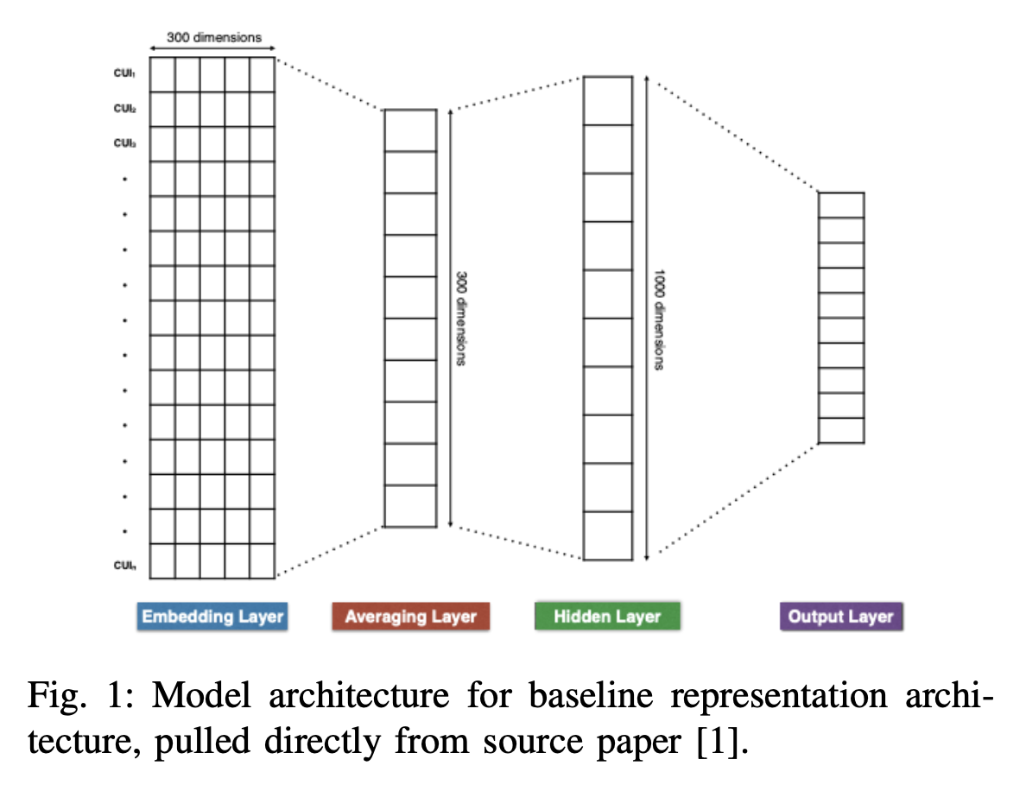
Methodology | Learned Representation Architecture

Slide 10
Methodology | SVM Model Set-Ups
Baseline #1: SVM w/ Bag-Of-Tokens (obtained from i2b2 Obesity Data)
TF-IDF Vectorizer – unigrams
SVM – class weights: “balanced” (adjust weights via freq.)
Baseline #2: SVM w/ SVD Representation (obtained from MIMIC-III)
TF-IDF Vectorizer – unigrams
SVD – 1000 dimensions (to mirror learned representation)
SVM – class weights: “balanced” (adjust weights via freq.)
Test Model: SVM w/ Learned Representation (obtained from DL model)
Must use MIMIC-III alphabet to correctly index embeddings in Learned Representation Model
Harvest hidden layer network weights for each patient.
SVM – class weights: “balanced” (adjust weights via freq.)

Slide 11
Methodology | Computational Implementation
Hardware:
Macbook Pros w/ Apple Silicon Chips (no proper GPU)
cTAKES – 10 docs/hours over 46,147 documents
Software Implementation:
PyTorch (instead of Tensorflow/Keras)
Deep Learning Architecture
RMSProp Optimizer & Binary Cross-Entropy Loss
Hyperparameters:
30 Epochs (instead of 75)
Batch Size – 50
Learning Rate – 0.001

Slide 12
Methodology | Code
Conversion of Tensorflow/Keras → PyTorch
Utilized boilerplate code from paper’s GitHub repository to mirror architecture set-up
Similar preprocessing techniques – but modeled to fit adjustment from not utilizing cTAKES
Closely mirrored evaluation code from paper’s GitHub repository
Ensures that differences in performance occur from preprocessing differences / model training
However, modified set-up to take in our PyTorch model
Implemented TF-IDF Vectorizer & SVD model from MIMIC-III patient-token matrix as not provided by repository.
Github Link – https://github.com/dcortese6/CSE6250-Project

Slide 13
Results | Patient Representation Model
Multi-Label Classification Problem – accuracy is not a good measurement
Metric: Macro F1 Score
considers class-based precision and recall
handles class imbalance
Validation Set on Patient Representation Model (after 30 epochs)
Macro F1 Score
80% on training set
66% on testing set
Binary Cross-Entropy Loss
0.09 minimum loss on training set
0.14 minimum loss on testing set
Notes:
Lower binary cross-entropy loss is good, means its accurate at its prediction but it is prone to overfitting
Overfitting due to training accuracy increasing while validation plateaus or decreasing

Slide 14
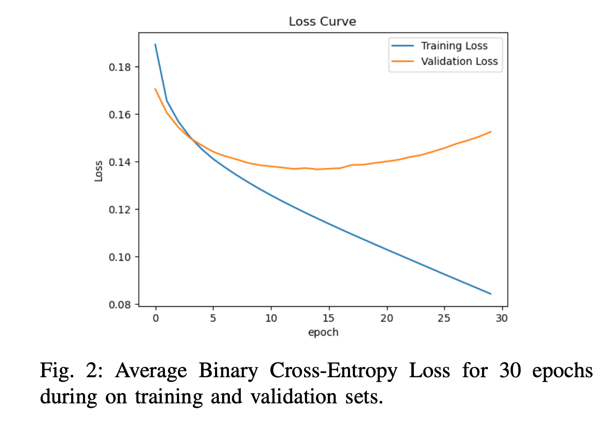
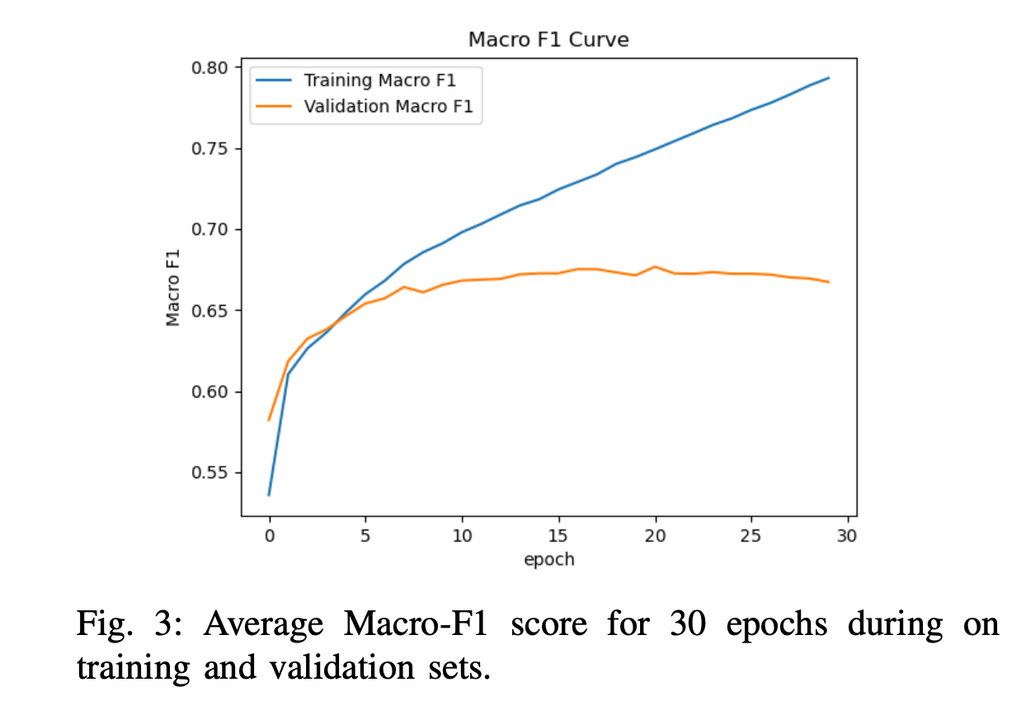
Results | Patient Representation Model

Slide 15
Results | Baseline SVMs vs. Patient Representation SVM
Reimplementation (with tokenization) vs. Paper’s CUI Implementation
Baseline SVMs slightly underperform paper’s CUI’s baseline models.
Some comorbidities are comparable or even OUT-PERFORMS, but the averages show a 5-10% decrease in across all metrics
Learned Representation underperforms paper’s counterpart model
Reimplementation shows ~18% decrease vs. their deep learning architecture
Insight: Tokenization not as effective, as extracting CUI’s
Their learned representation model outperforms baseline, ours does not.
Cannot confirm the paper’s original hypothesis with our given implementation.

Slide 16
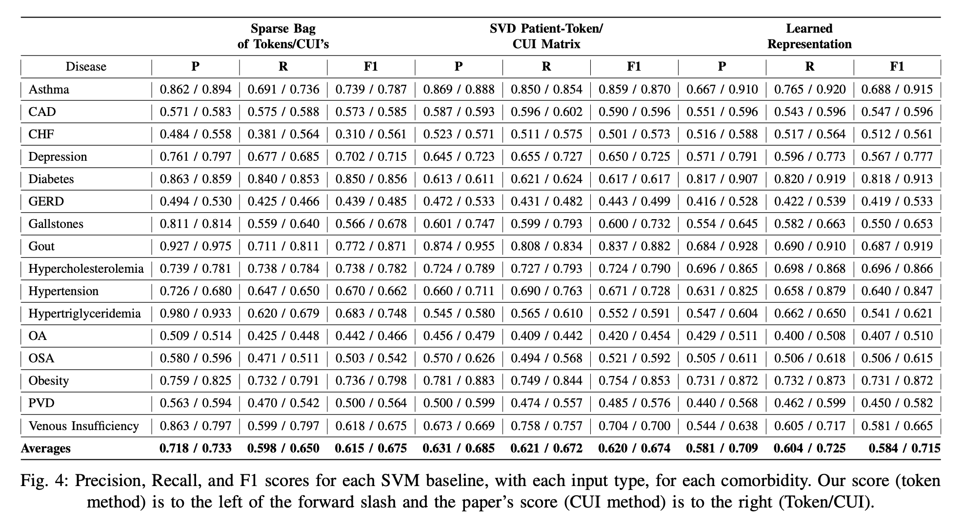
Results | Baseline SVMs vs. Patient Representation SVM

Slide 17
Discussion | Next Steps
Reproducibility? – YES
Our results clearly under-perform their model… however,
(1) representation model architecture most likely over-fit
struggles to generalize the clinical notes via tokenization method vs. UMLS CUIs
Silver Lining? – model still somewhat effective (not far off from baseline models)
Difficulties?
CUI Extraction – too slow with cTAKES & pyMetaMap
Computational Resources - no proper GPU

Slide 18
Discussion | Next Steps
Ease?
Great explanations of their architecture and how they harvested their representations
Clear hypothesis, experiments, and findings
Improvements?
Clearer expectations of how pre-processing occurred
Explanation/Demo of their cTAKES utilization (no code or reference in their repository)
Organization / Folder Structure Clarity
deduced hierarchy through intuition

Slide 19
References
[1] Dligach, Dmitriy, and Timothy Miller. “Learning patient representations from text.” Proceedings of the Seventh Joint Conference on Lexical and Computational Semantics, 2018, https://doi.org/10.18653/v1/s18-2014.
[2] Johnson, Alistair E.W., et al. “Mimic-III, a freely accessible Critical Care Database.” Scientific Data, vol. 3, no. 1, 2016, https://doi.org/10.1038/sdata.2016.35.
[3] Tomas Mikolov, Kai Chen, Greg Corrado, and Jeffrey Dean, Efficient estimation of word representations in vector space, 2013, arXiv preprint arXiv:1301.3781

Slide 20
References
[4] Khalafi, Sahar, et al. “A hybrid deep learning approach for pheno- type prediction from Clinical Notes.” Journal of Ambient Intelligence and Humanized Computing, vol. 14, no. 4, 2023, pp. 4503–4513, https://doi.org/10.1007/s12652-023-04568-y.
[5] Uzuner, O. “Recognizing obesity and comorbidities in sparse data.” Journal of the American Medical Informatics Association, vol. 16, no. 4, 2009, pp. 561–570, https://doi.org/10.1197/jamia.m3115.

